Slide 1
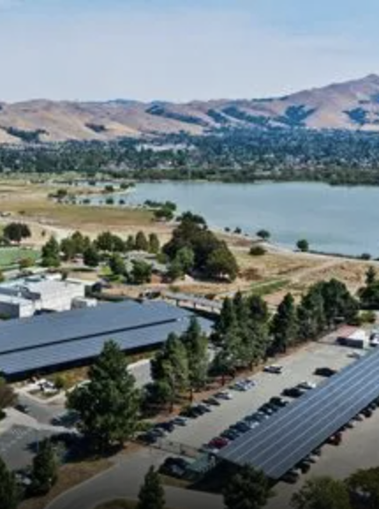
WATER SHORTAGE VULNERABILITY
IN ALAMEDA COUNTY
Drew Barnhart, Lorela Cabral, Luis Hernandez, Daniel Rodriguez
Notes:
Drew

Slide 2

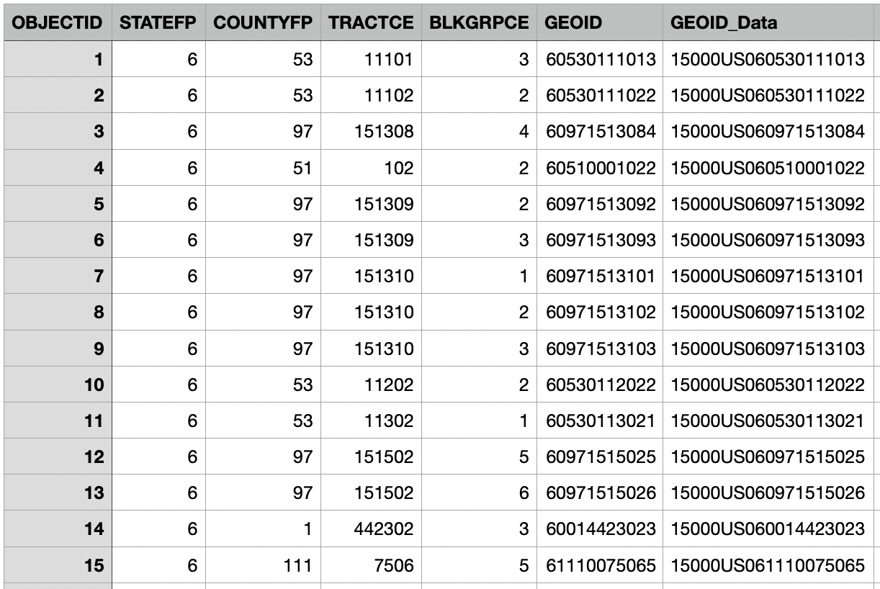
DATASET
Water Shortage Social Vulnerability in California
This dataset was collected by the CA Department of Water Resources, joined to the 2020 Census Block Groups.
Some social and economic factors that were collected include:
Mean Household Income
Percentage with High School Diploma
Proportion Below Poverty
Development Tracts of land by GEOID
These factors were then used to create a social vulnerability score that identified communities at risk for drought and water storage.
Notes:
Drew
Should probably create some sort of background/story:
Indications were pulled from the self-reported American Communities Survey
The goal of the data was to provide a spatial representation of social and economic factors that can affect water shortage
vulnerability in CA
Indicators were rescaled and summed to calculate the Water Shortage Social Vulnerability as defined by the CA Department of Water Resources
The data can now be used to collect a relative summary of which communities are most at risk for drought and water storage

Slide 3
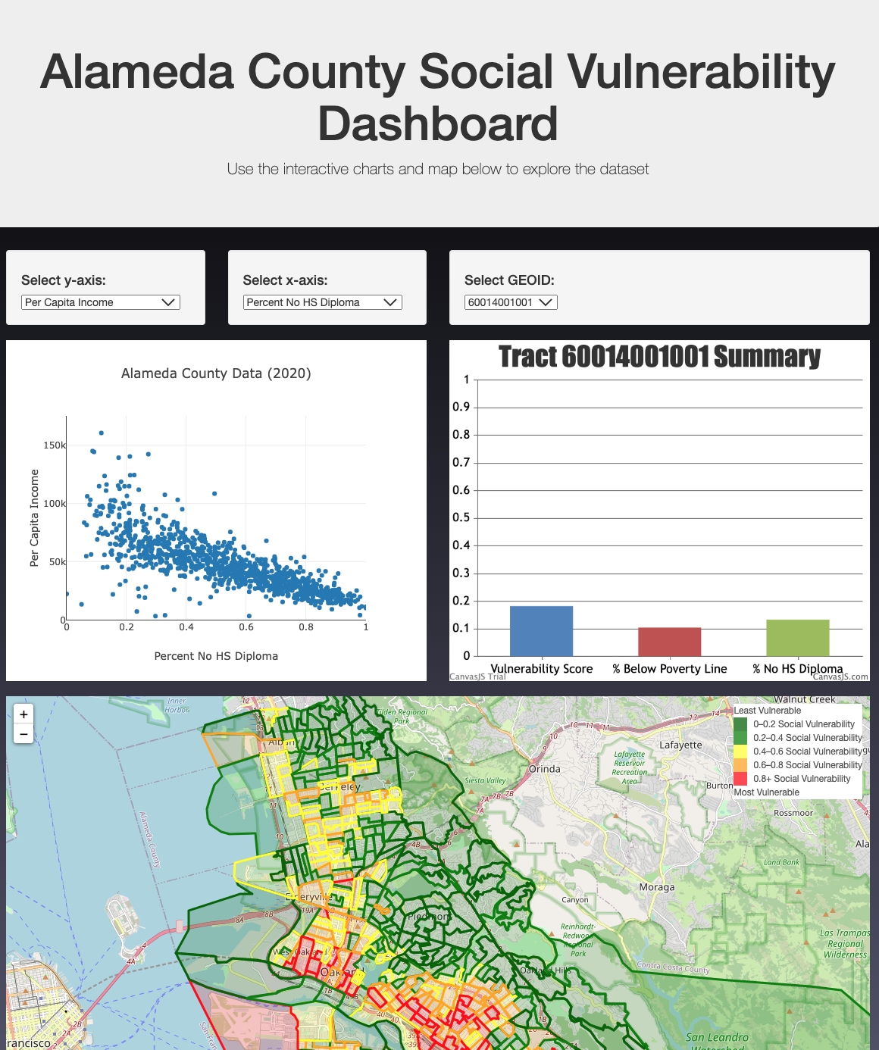
TOPIC & PURPOSE
User Empowerment
The motivation of this project is to analyse socioeconomic factors and how they can be correlated to water shortage vulnerability.
The main objective is to provide an interface that empowers users to perform a variety of analyses from a single dashboard.
The data was limited to Alameda County but can be easily configured for users interested in other counties within California.
Notes:
Drew

Slide 4
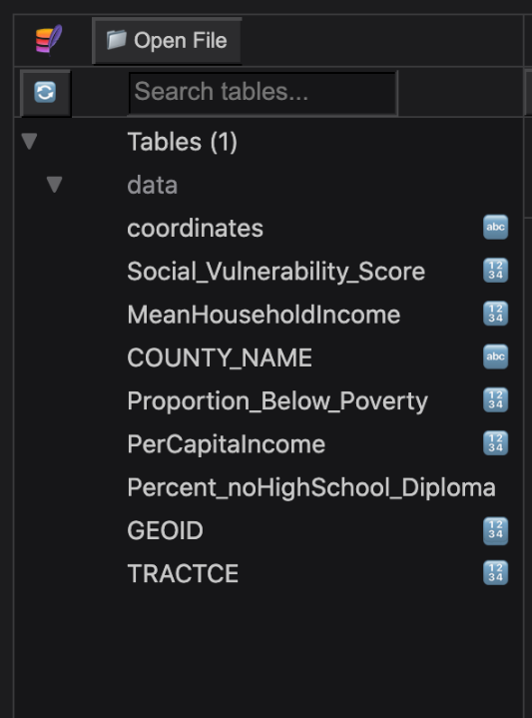
DATABASE
Python & SQLite
Our dataset included over ~23,000 rows of data, so to refine it we chose to use the data from one county (Alameda).
We used python to clean the data by reading the GEOJson into a jupyter notebook and filtering the appropriate columns for analysis.
Lastly, we pushed our dataframe to SQLite and created a table of our data with a final length of 1,074 rows.
Notes:
Daniel

Slide 5
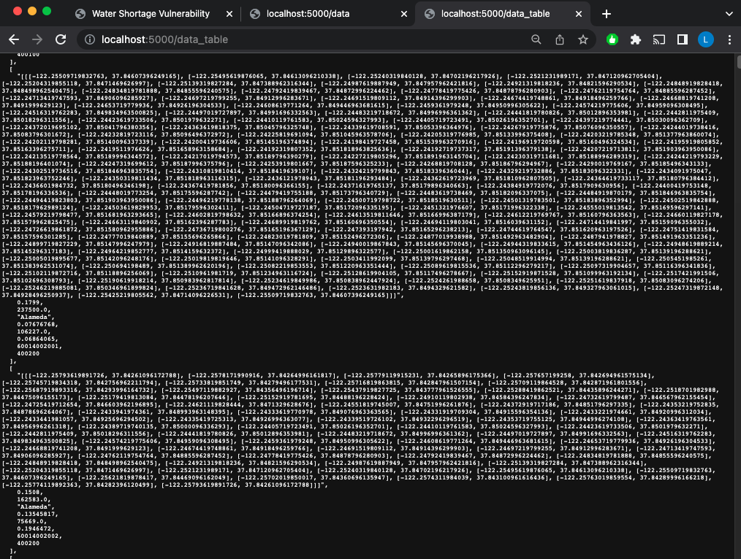
FLASK APP
Flask app.py
Our Flask app served the data from the SQlite database to two locations:
5000/data
coordinates only for generating the polygons
5000/data_table
Coordinates and all columns with relevant data
Used to populate our visualizations
Notes:
Daniel
Pulls

Slide 6
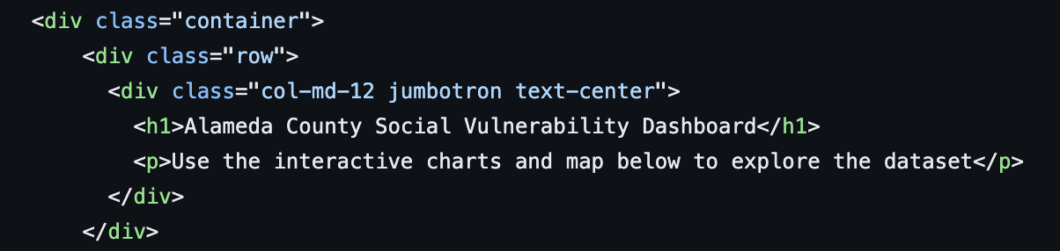
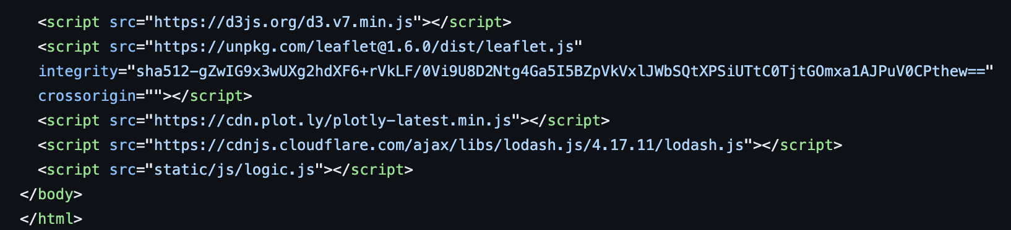
DASHBOARD
HTML
Our dashboard consisted of five total sections which we put into a container.
Interactive map
Two wells for the dropdowns to choose x and y axis for the scatter plot
Conditional scatter plot
Dropdown for GEOID selection
Canvas.js column chart
We also included the script for the new js library that we integrated, canvas.js.
Notes:
Drew

Slide 7
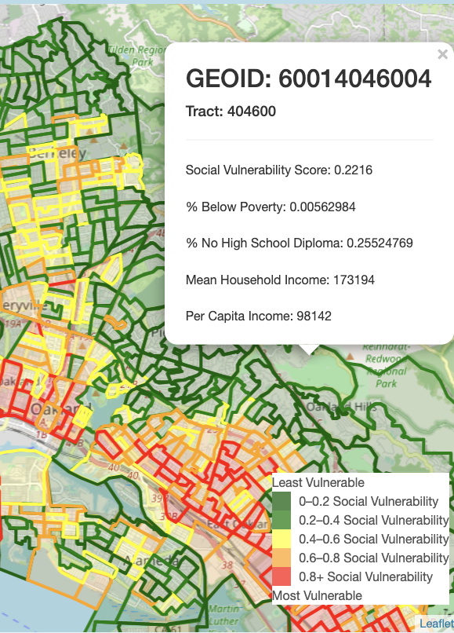
MAP
logic.js
The data was returned using d3.json
Leaflet and openstreetmap were used to generate the basemap and polygons. While iteratively created the polygons, a function is called to check the social vulnerability score to return the polygon color.
We used .bindPopup to provide summary information of a tract of land when the user clicks on a polygon. The unique ID for the tracts of land is GEOID.
The legend is displayed to provide the user with a clear indication of which tracts of land are the least to most vulnerable according to their score.
Notes:
Luis

Slide 8
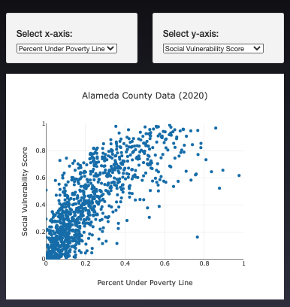
SCATTER PLOT
logic.js, HTML
To create the scatterplot, we created a for loop that stored each column of our dataset into lists.
The wells for selecting the x and y axis allow the user to choose which factors they want to plot.
Plotly was used to plot the scatter plot based on the user’s choice of axes.
By hovering over each point of the scatterplot, the GEOID is visible.
Notes:
Lorela

Slide 9
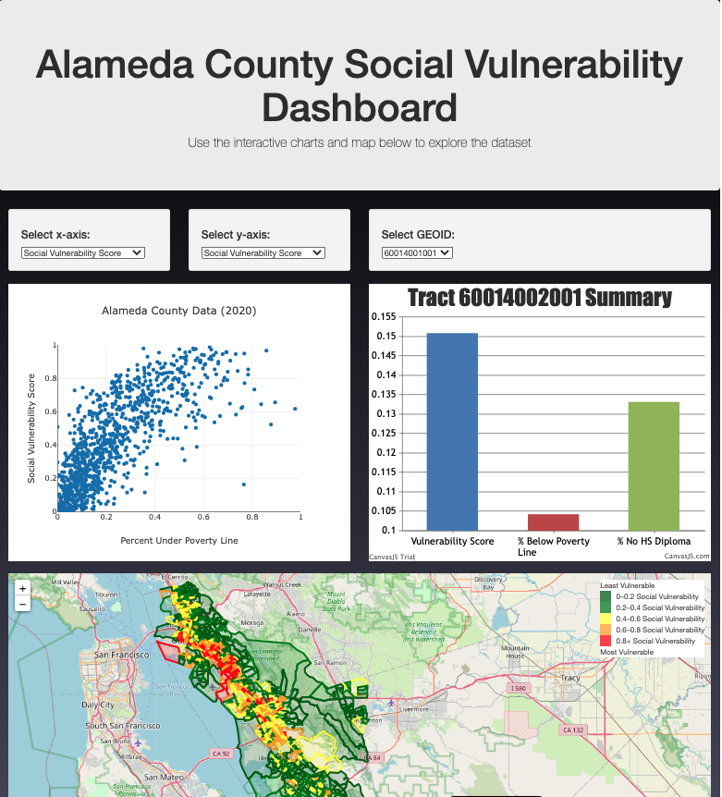
COLUMN CHART
logic.js, HTML, canvas.js
To create the bar chart, we used a similar for loop to store the data as lists.
For this chart, the user can select which GEOID they want to graph.
This will show comparisons between the Vulnerability Score, % between poverty line, and % no high school diploma.
Canvas.js was used to plot the bar chart.
Notes:
Daniel

Slide 10
LIMITATIONS OF THE DATA
AND NEXT STEPS
ANTIQUATED
SELF REPORTED
The data collected ranges from 2015-2019 (indicators from the American Communities Survey) and 2020 (Census Block Groups), so they may not be representative of the true population today.
US census data is self reported and majority of the information is unverified. Statistics in our data/analysis (especially household income) is susceptible to being over/under exaggerated.
OTHER INTERACTIONS
STATISTICAL ANALYSIS
Further visualizations to add to our data could be made by linking plots together. Similarly, we can add more counties to this analysis but will need to improve speed of polygon display.
Though trends can be observed, we can run statistical tests (such as linear regression) with the data to determine if there is a correlation between location, socioeconomic factors and vulnerability.
Notes:
Lorela

Slide 11
THANKS!
Notes:
Luis
Switch to dashboard to show interactive features

